Slide 1
DR.SNSRCAS, CBE
SUBJECT: CLOUD TECHNOLOGY FUNDAMENTALS
COURSE CODE:21UCA501 UNIT - IV
TITLE: Google analytics
YEAR: III SEMESTER 2022-2023 (ODD)

Slide 2
Google Analytics
Google Analytics (GA; http://google.com/analytics) is a statistical tool that measures the number and types of visitors to a Web site and how the Web site is used. To validate Web sites used.
It is offered as a free service and has been adopted by many Web sites.
GA is built on the 5 analytical package that Google acquired in 2006

Slide 3
Google Analytics
According to Builtwith.com (http://trends.builtwith.com/analytics/Google-
Analytics), Google Analytics was in use on 54 percent of the top 10,000 and 100,000, and 35
percent of the top one million of the world’s Web sites.
Builtwith.com speculates that Google
Analytics JavaScript tag is the most widely used URL in the world today.

Slide 4
Google Analytics
The service BackendBattles.com (http://www.backendbattles.com/backend/Google_Analytics) sets GA’s market share at 57 percent for the top 10,000 sites.

Slide 5
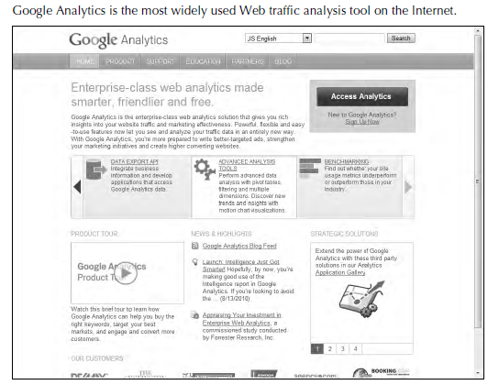

Slide 6
Google Analytics
The service BackendBattles.com (http://www.backendbattles.com/backend/Google_Analytics) sets GA’s market share at 57 percent for the top 10,000 sites.

Slide 7
Google Analytics
The service BackendBattles.com (http://www.backendbattles.com/backend/Google_Analytics) sets GA’s market share at 57 percent for the top 10,000 sites.

Slide 8
Google Analytics
Analytics works by using a JavaScript snippet called the Google Analytics Tracking Code (GATC) on individual pages to implement a page tag.
When the page loads, the JavaScript runs and creates a first-party browser cookie that can be used to manage return visitors, perform tracking, test browser characteristics, and request tracking code that identifies the location of the visitor.

Slide 9
Google Analytics
GATC requests and stores information from the user’s account.
The code stored on the user’s system acts
like a beacon and collects visitor data that it
sends back to GA servers for processing.

Slide 10
Google Analytics
Among the visitors that can be tracked are those that land from search engines; referral links in e-mail, documents, and Web pages; display ads; PPC networks (PPC stands for pay-per-click, a model of internet marketing in which advertisers pay a fee each time one of their ads is clicked) and some other sources.

Slide 11
Google Analytics
GA aggregates the data and presents the information in a visual form.
GA also is connected to the AdWords system so it can track the performance of particular ads in different contexts.
You can view referral location statistics and time spent on a page, and you can filter by visitor site.

Slide 12
Google Analytics
GA lets you save and store up to 50 individual site profiles, provided the site has less than 5 million pageviews per month.
GA cookies are blocked by a number of technologies, such as Firefox Adblock and NoScript or by turning off JavaScript execution in other browsers. You also can delete GA cookies manually or block them, which also defeats the system.

Slide 13
Thank You

